Slide 1
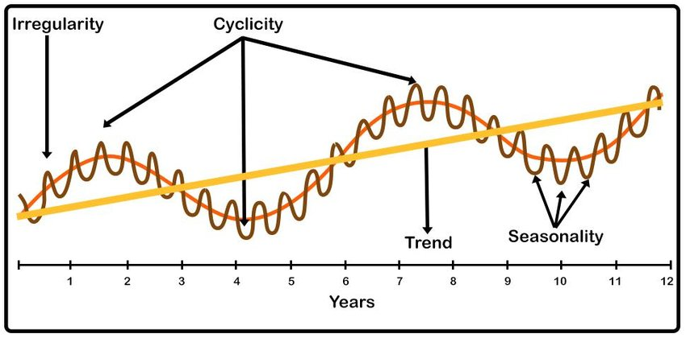
Time Series Price Prediction
John Rizzo, Mathew Kawaja, Leor Yomtobian
EE595, Professor Shucheng Yu
LY
Notes:
Image Credit: https://www.researchgate.net/figure/Time-Series-components-1-A-time-series-is-a-sequence-of-observations-measured-at_fig1_344658764
Financial forecasting presents challenges due to the chaotic, noisy, and nonlinear nature of market data. This paper investigates the application of deep learning techniques for time-series price prediction in financial markets, focusing on daily OHLCV data. The study compares three models: Ordinary Least Squares (OLS), Patch Time Series Transformer (PatchTST), and a custom Long Short-Term Memory (LSTM) architecture.

Slide 2
Problem Statement
Predict the next closing price of stocks using daily OHCLV (Open, High, Low, Close, Volume) data
Three different architectures used:
MLP (OLS)
PatchTST
LSTM
Objective is to compare the performance of each model and to have accurate predictions
MK
Notes:
The objective of our research is to develop a state of the art model using deep learning techniques that matches or exceeds existing methods such as Ordinary Least Squares (OLS) and Patch Time Series Transformer (PatchTST) using only the daily OHCLV (Open, High, Low, Close, Volume) features supplemented with additional custom features that can be generated from this data. During our research we have implemented OLS, PatchTST and a custom LSTM deep learning architecture. The custom LSTM deep learning model did in fact exceed the performance of both OLS and PatchTST while at the same time being generalizable to additional assets.

Slide 3
Dataset Description
The data we used were the daily Stocks and Bonds pricing
The dataset contains 24.3 million rows
Each row contains the symbol, date, open, high, low, close, and adjusted close
We handled missing values by incorporating a two-step forward (ffill) then backward (bfill) fill, ensuring a continuous time series
Any remaining NaN values from this process are dropped, providing a clean dataset for modeling
JR

Slide 4
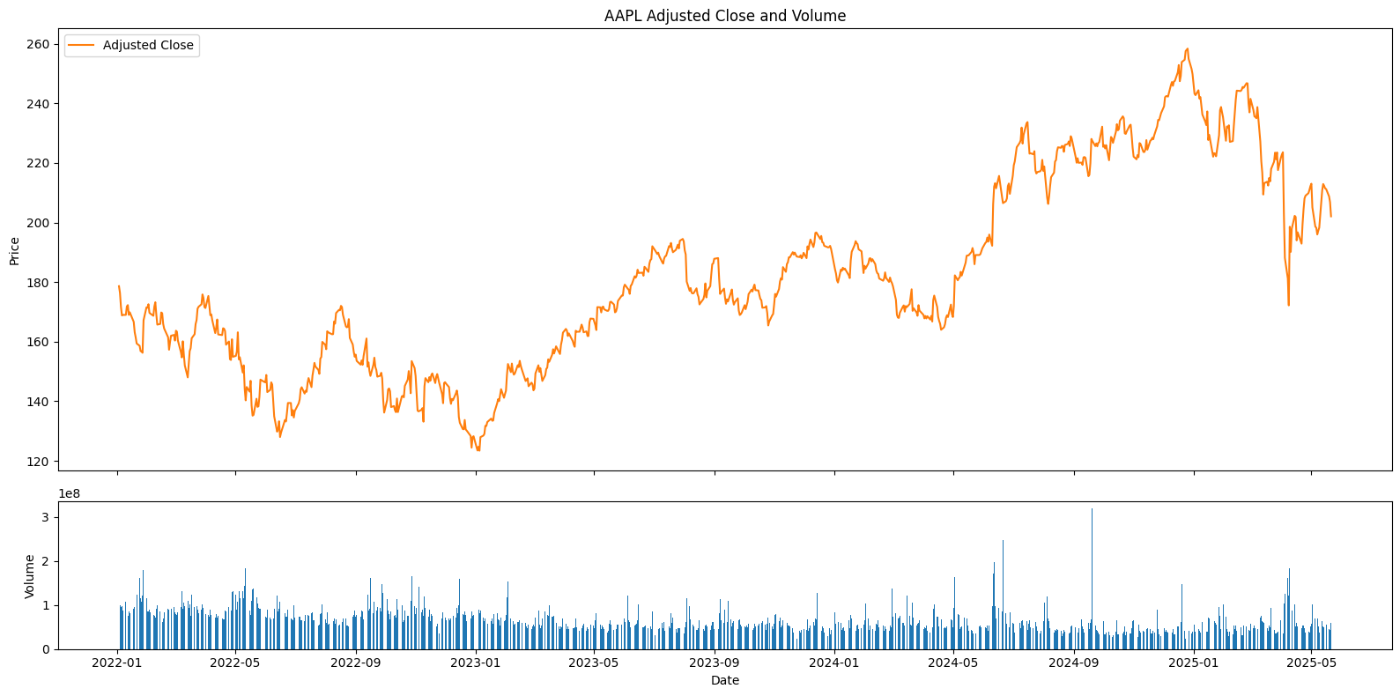
AAPL Adjusted Close vs Volume from 2022-01 to 2025-05
JR

Slide 5
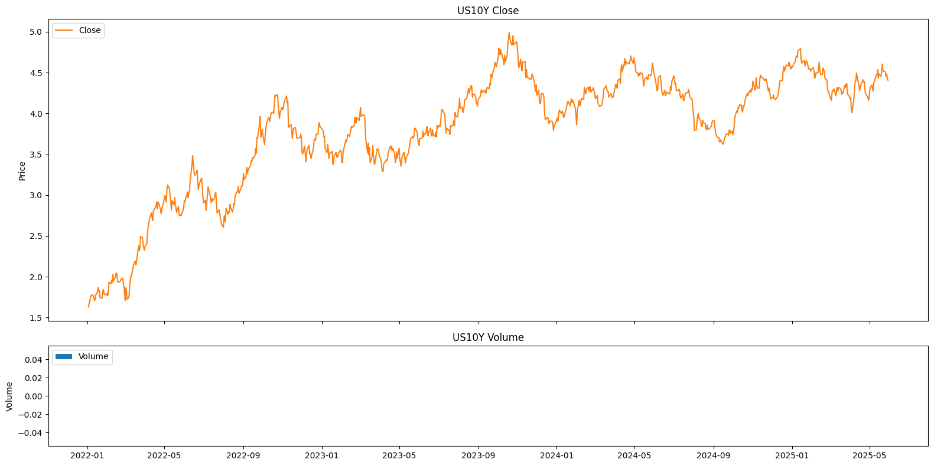
US10Y Bond Close from 2022-01 to 2025-05
JR

Slide 6
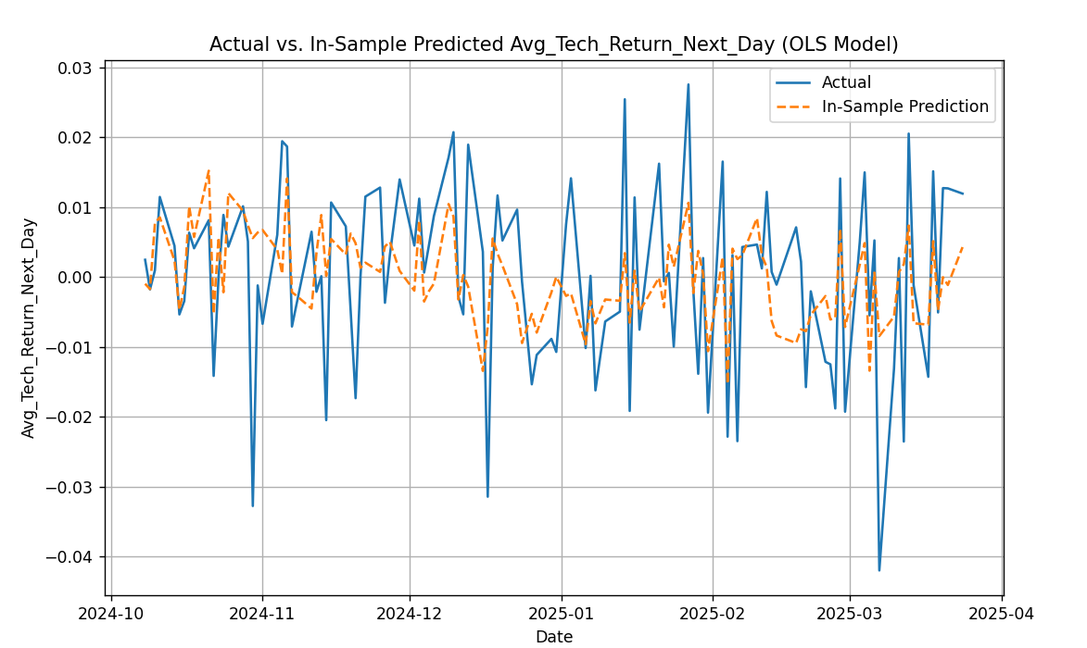
OLS Model In-Sample Fit: Average Tech Stock Returns
MK
Notes:
This first graph shows the Actual Average Tech Stock Return for the next day (blue line) against our OLS model's In-Sample Prediction (red dashed line). We can observe how closely the red dashed line follows the blue line. A perfect prediction would mean the lines overlap perfectly. From this visual, we can gauge if our OLS model is capturing the general trends or patterns in tech stock returns, even if it's not perfectly precise on a day-to-day basis. We typically expect OLS to struggle more with the high volatility of daily stock returns, which is often a very noisy signal.

Slide 7
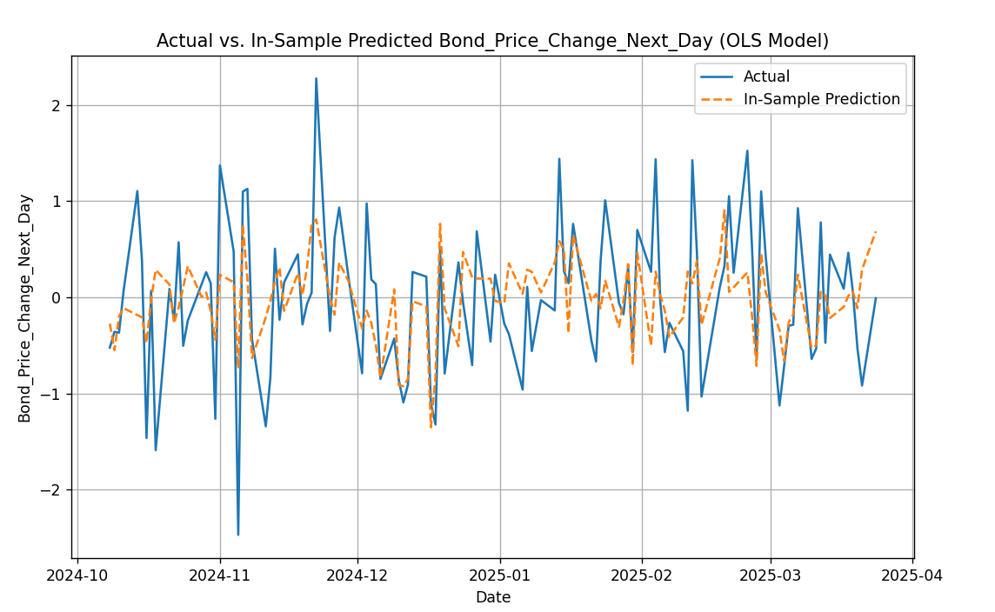
OLS Model In-Sample Fit: Bond Price Changes
MK
Notes:
Similarly, this second graph visualizes the Actual Bond Price Change (blue line) versus the OLS model's In-Sample Prediction (red dashed line). Bond prices, specifically long-term treasuries like TLT, tend to be less volatile than individual tech stocks. We might expect the OLS model to show a somewhat better fit here, potentially capturing more of the underlying trend or magnitude of daily changes. This graph helps us see if the model has learned the relationship between our features and the bond market's daily fluctuations. While these plots give us an initial visual sense of the model's fit, remember that in-sample performance doesn't directly translate to out-of-sample (future) performance. The real test comes when we evaluate the model on data it has never seen before – which is why robust walk-forward validation is critical. These plots primarily confirm that the model is indeed learning something from the data it's given.

Slide 8
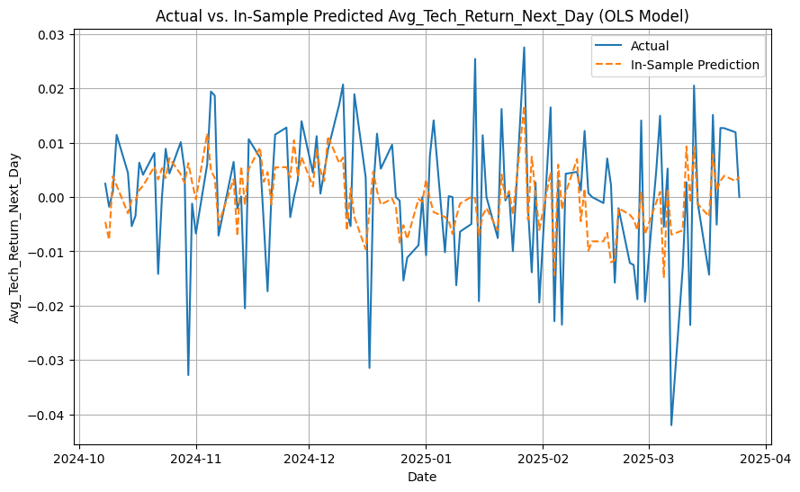
OLS Equity
MK
Notes:
Our OLS model's performance for predicting OS Equity prices is displayed here. The actual historical equity data is shown in blue, with our model's predictions in dashed red. This graph provides a clear view of how effectively our linear regression model, utilizing its given features, captures the general trajectory and critical shifts in this key equity market.

Slide 9
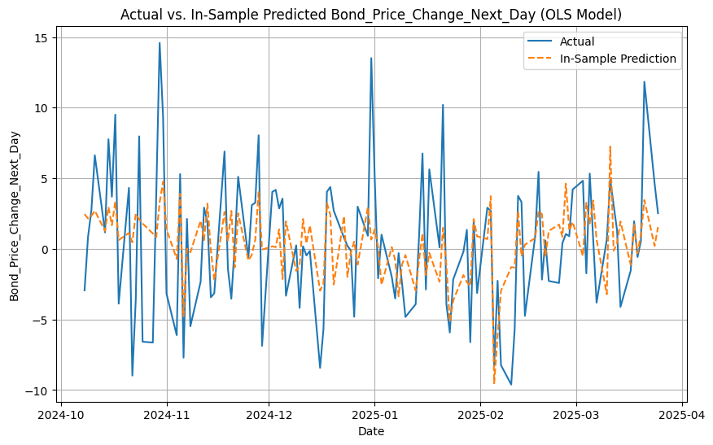
OLS US10Y Bond
MK
Notes:
Here we see the performance of our OLS model for predicting the US 10-Year Treasury Bond yield. The blue line represents the actual historical 10-year yield, while the dashed red line shows our model's predictions. This visualization helps us understand how well our linear regression model is able to track and explain movements in bond yields based on the features we've provided it. We're observing if the model captures the general trend and turning points in this critical interest rate.

Slide 10
Patch Time Series Transformer (PatchTST)
Machine learning algorithms:
One of the Machine Learning algorithms we used was PatchTST
PatchTST is a transformer-based deep learning architecture for time series forecasting
It is designed to capture nonlinear and complex patterns
It treats time series like a sequence of patches, which allows it to capture short and long term patterns
LY

Slide 11
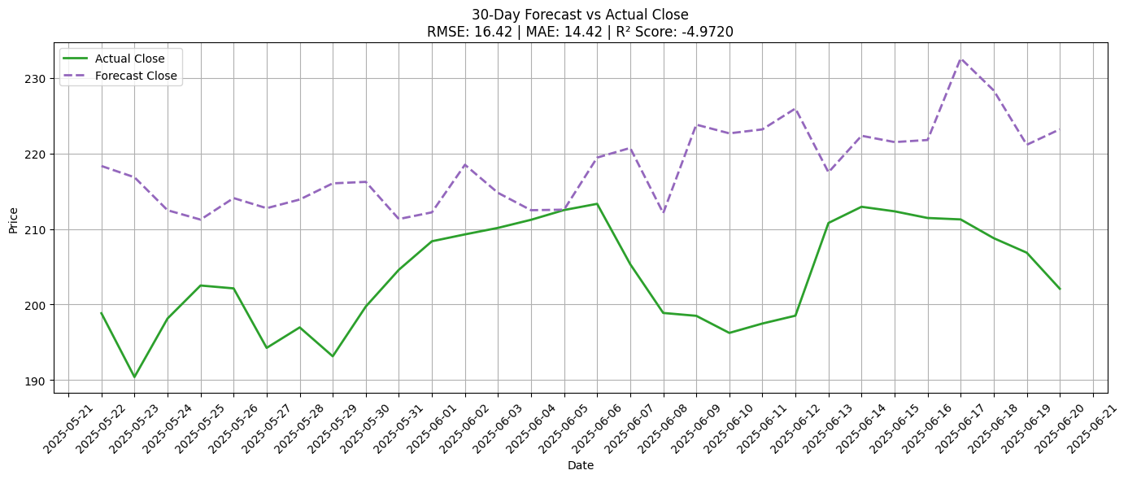
PatchTST for AAPL Equity
LY

Slide 12
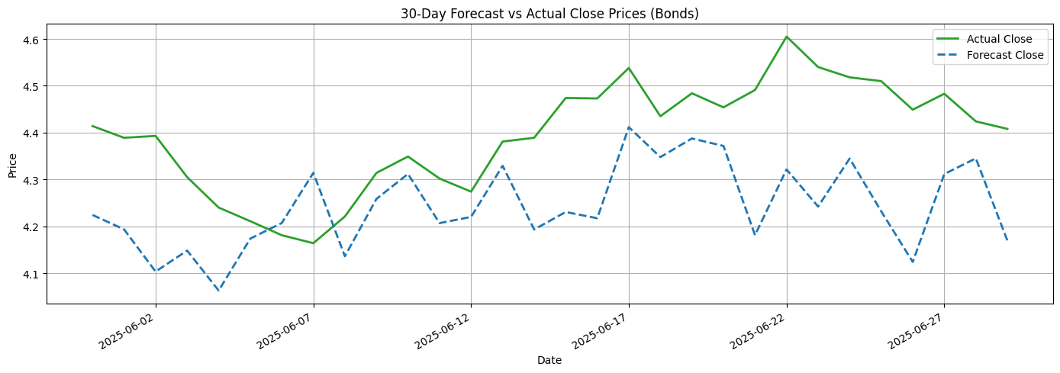
PatchTST for US10Y Bond
LY

Slide 13
Long Short-Term Memory (LSTM)
LSTM is a recurrent neural network designed to capture sequential dependencies via gated memory cells. It has been widely used for financial time-series because it can learn complex, non-linear temporal patterns that linear models cannot
LSTMs are not inherently interpretable. The stateful weights and non-linear activations make it hard to trace how inputs map to outputs.
LSTMs can overfit easily on noisy daily data, especially if the signal-to-noise ratio is low. They require large amounts of data and careful hyperparameter tuning.
JR

Slide 14
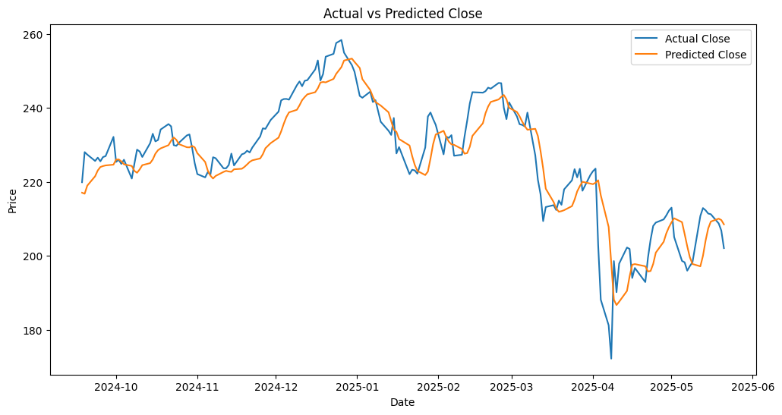
LSTM AAPL Equity
JR

Slide 15
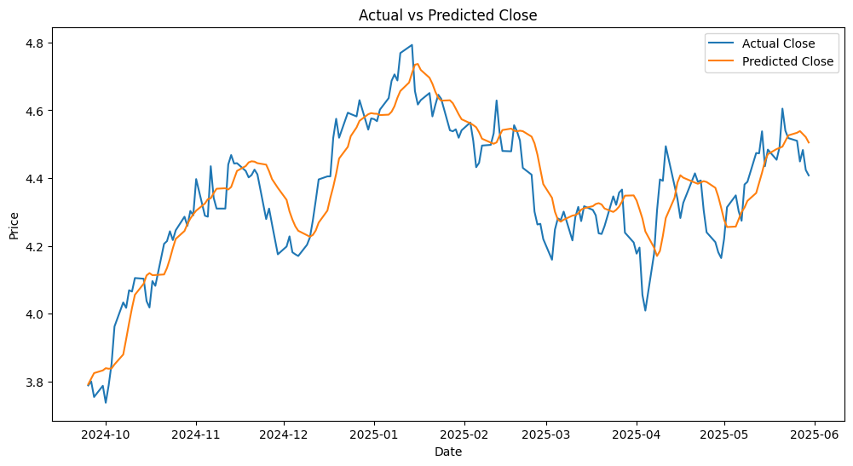
LSTM US10Y Bond
JR

Slide 16
Thank You
John Rizzo
jrizzo2@stevens.edu
Matthew Kawaja
mkawaja@stevens.edu
Leor Yomtobian
lyomtobi@stevens.edu
LY
Notes:
Conclusion
We were successful in developing a traditional, contemporary and frontier model for price prediction. Comparing the models indicates that the LSTM deep learning approach holds considerable promise and further research in this area should be conducted.

